Slide 1

RIGHTIES vs.
LEFTIES in
2015

Slide 2
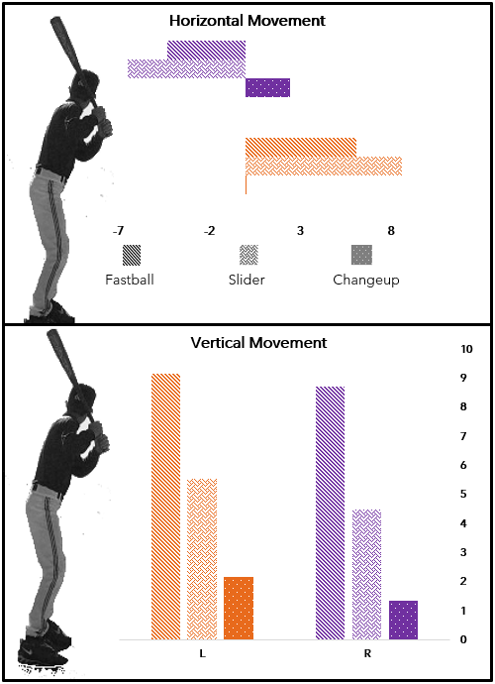
Right Hand Pitching moves
Toward a Right Handed Batter
Left Handed Pitching moves
Away from a Right Handed batter
In 2015, Left Handed exceed Right Handed Pitchers in both vertical and horizontal pitch movement for power pitches.

Slide 3
